Slide 1
Odd one out
By Swaroop Devaraju

Slide 2
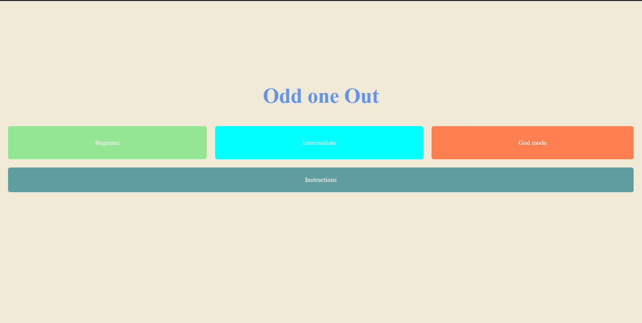
Design

Slide 3
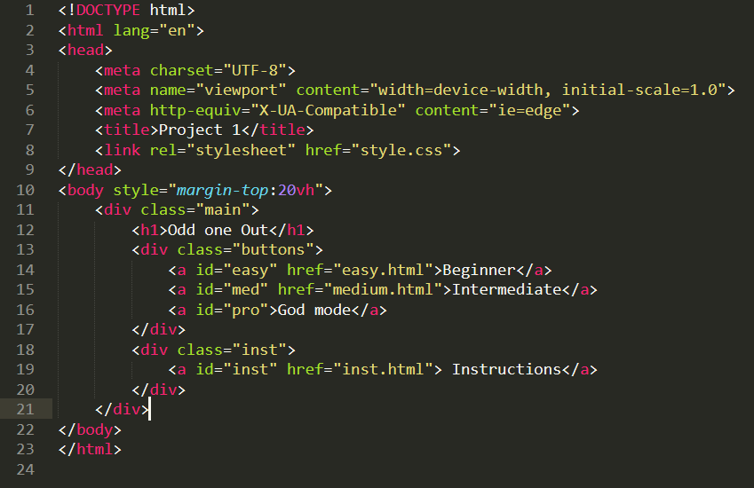
HTML

Slide 4
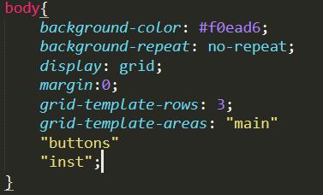
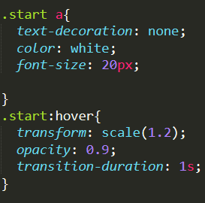
CSS
Grid.
Hover.
Transform.

Slide 5
Demo

Slide 6
Thank you

